Slide 1
Efficient Image Poisoning as Defense: Disrupting Profile Matching on OSNs and Preserving Human Comprehension
Course: CS577 Data Privacy
Course Instructor: Asst. Prof. Sinem Sav
Group Number 03:
Aqsa Shabbir
Kousar Saleem
Noor Muhammad
Mehmet Kadri Gofralılar
Ecem İlgün
Date: 14th March, 2024

Slide 2
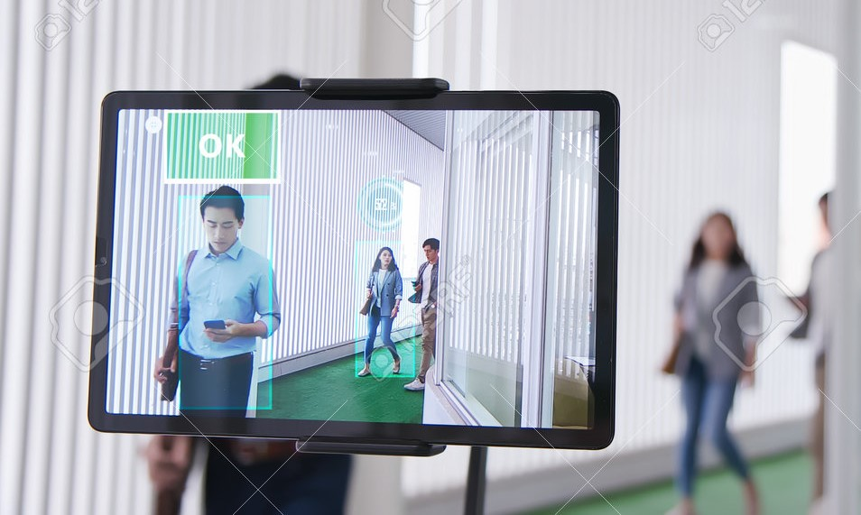
Facial Recognition:
Facial recognition is extensively utilized in everyday devices.
Expedite identification processes and enhance overall safety measures.
Retailers utilize facial recognition technology to analyze customer demographics.
Social media platforms integrate facial recognition algorithms for automatic tagging of friends in photos.
Notes:
Facial recognition is extensively utilized in everyday devices such as smartphones for secure authentication, enabling users to unlock their devices with a simple glance or a touch.
Security systems at airports, train stations, and other public venues increasingly rely on facial recognition technology to expedite identification processes and enhance overall safety measures..
Social media platforms integrate facial recognition algorithms to streamline user experiences, allowing for automatic tagging of friends in photos and delivering personalized content recommendations.
Retailers utilize facial recognition technology to analyze customer demographics and behavior, enabling targeted marketing strategies and enhancing customer engagement.

Slide 3
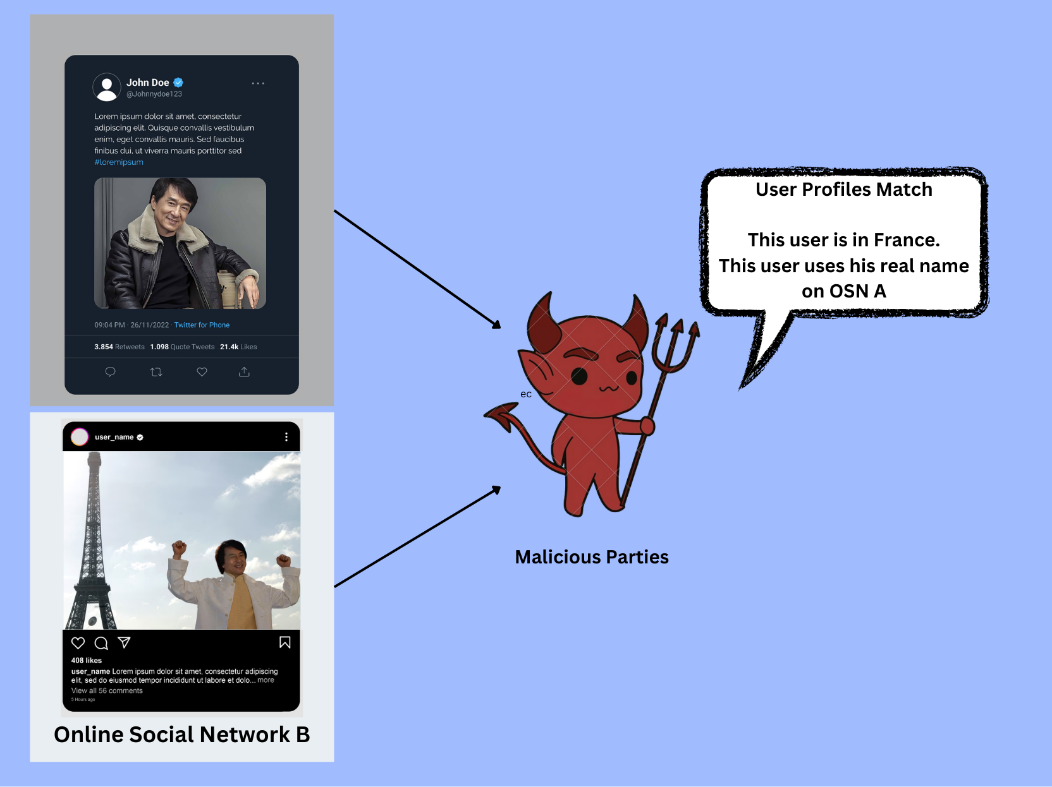
What About Privacy?
Invasive Data Collection
Surveillance and Tracking
Lack of Consent
Potential for Misuse
Notes:
As facial recognition technology becomes more common, we need to think about how it affects our privacy. When our faces are scanned, it can invade our personal space and take away our control over our own information.As we deal with this technology, it's important to remember that while it can be convenient, it shouldn't harm our right to privacy. Our online identities need to be kept safe, and rules should be in place to make sure facial recognition doesn't invade our privacy

Slide 4

Objective: Obfuscate faces in images
Enhanced Privacy Protection
Prevents Biometric Data Collection
Mitigating the risks of unauthorized facial recognition
Protecting individuals' identities
Notes:
Obfuscating faces in images means hiding or blurring them so that they can't be easily recognized. It's a way to protect people's privacy when sharing photos or videos, especially if they haven't given permission to be show.
Whether you're posting pictures online, going to events, or doing stuff on the internet, our way of hiding faces gives you control. You can feel secure knowing your privacy is being looked after and kept safe.

Slide 5
Related Work
AdvFaces: Adversarial Face Synthesis^{[1]}
Relevance | Introduction | Methodology | Dataset | Strengths | Weakness
Making changes to facial pictures to specifically trick facial recognition systems to make mistake | Creating adversarial images that both have high perceptual quality and can be generated quickly | Utilizes GANs to generate minimal perturbations in salient facial regions | LFW | High success rates in evading detection by black-box face recognition systems | Utility
1) Deb, D., Zhang, J., & Jain, A. K. (2020, September). Advfaces: Adversarial face synthesis. In 2020 IEEE International Joint Conference on Biometrics (IJCB) (pp. 1-10). IEEE.

Slide 6
Related Work
Poison Frogs! Targeted Clean-Label Poisoning Attacks on Neural Networks^{[2]}
Relevance | Introduction | Methodology | Dataset | Strengths | Weakness
Focuses on data poisoning attacks targeting neural networks | Crafting poison instances that subtly modify training data to mislead neural network models | optimization-based method for crafting poisons | CIFAR-10 ^{[3]} | No need for altering the labels of poison instances | Scalability
2) Shafahi, A., Huang, W. R., Najibi, M., Suciu, O., Studer, C., Dumitras, T., & Goldstein, T. (2018). Poison frogs! targeted clean-label poisoning attacks on neural networks. Advances in neural information processing systems, 31. 3) Alex Krizhevsky and Geoffrey Hinton. Learning multiple layers of features from tiny images. 2009. Available on: https://www.cs.toronto.edu/~kriz/cifar.html

Slide 7
Related Work
A Study of Face Obfuscation in ImageNet^{[4]}
Relevance | Introduction | Methodology | Dataset | Strengths | Weakness
face obfuscation techniques on the accuracy and reliability | comprehensive analysis of face obfuscation on ImageNet | Obfuscation techniques applied to faces within ImageNet images, such as blurring, pixelation | ImageNet^{[5]} | Effectiveness of obfuscation techniques in preserving individual privacy | Negatively impacting the utility of images
4) Kaiyu Yang, Jacqueline H Yau, Li Fei-Fei, Jia Deng, and Olga Russakovsky. A study of face obfuscation in imagenet. In International Conference on Machine Learning, pages 25313–25330. PMLR, 2022. 5) Deng, J., Dong, W., Socher, R., Li, L.-J., Li, K., and Fei-Fei, L. Imagenet: A large-scale hierarchical image database. In Conference on Computer Vision and Pattern Recognition, 2009.
Notes:
The methodology includes annotating faces within the ImageNet dataset using Amazon Rekognition and crowdsourcing for refinement, followed by assessing the impact of face obfuscation (blurring and overlaying) on model recognition accuracy and feature transferability

Slide 8

Adversarial Model
Adversary
Social Media Service Provider
(semi-honest party)
Vulnerability
Individuals, places and objects can be easily tagged in the images and used for additional inference.
Threat
Perform additional inferences using the user’s images beyond user’s expectations.
Harm
Unwanted surveillance and/or information leak.

Slide 9
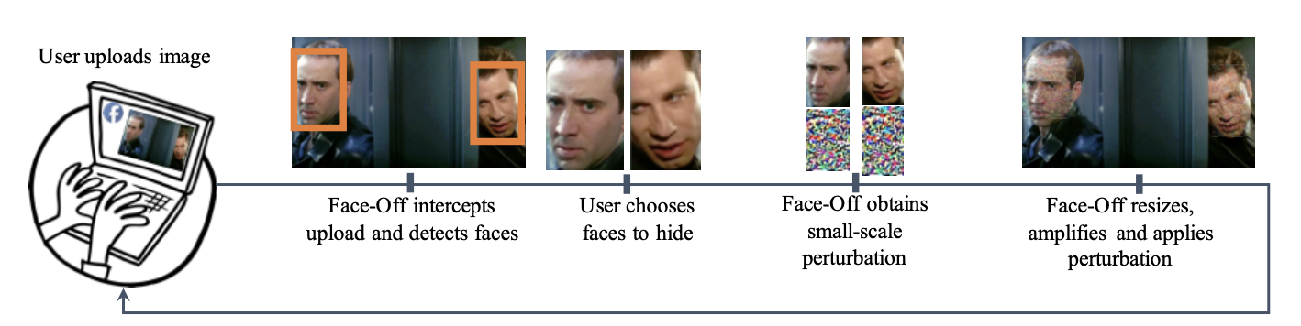
Overview Of Face-off ^{[6]}
A privacy-preserving framework that introduces strategic perturbations to the user’s face to prevent it from being correctly recognized.
Challenges:
Existing approaches target classification networks and must be retrofit for metric learning.
Black box nature of facial recognition models of social media platforms.
6) Chandrasekaran, V., Gao, C., Tang, B., Fawaz, K., Jha, S., & Banerjee, S. (2020). Face-off: Adversarial face obfuscation. arXiv preprint arXiv:2003.08861.

Slide 10
Methodology
Design two new loss functions:
Contrastive loss ^{[6]}
Triplet loss ^{[6]}
Capitalize on the transferability using Surrogate models.
Designed based on two popular approaches:
Projected Gradient Descent (PGD) ^{[7]}
Carlini and Wagner approach (CW) ^{[8]}
Surrogate models:
FaceNet ^{[9]}
CenterNet ^{[10]}
7) A. Madry, A. Makelov, L. Schmidt, D. Tsipras, and A. Vladu, “Towards deep learning models resistant to adversarial attacks,” arXiv preprint arXiv:1706.06083, 2017. 8) N. Carlini and D. Wagner, “Towards evaluating the robustness of neural networks,” in Security and Privacy (SP), 2017 IEEE Symposium on. IEEE, 2017, pp. 39–57.
9) Schroff, F., Kalenichenko, D., & Philbin, J. (2015). Facenet: A unified embedding for face recognition and clustering. In Proceedings of the IEEE conference on computer vision and pattern recognition (pp. 815–823).
10) Duan, K., Bai, S., Xie, L., Qi, H., Huang, Q., & Tian, Q. (2019). Centernet: Keypoint triplets for object detection. In Proceedings of the IEEE/CVF international conference on computer vision (pp. 6569-6578).

Slide 11
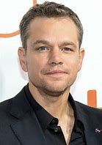
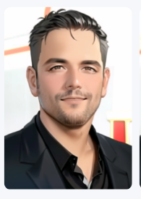
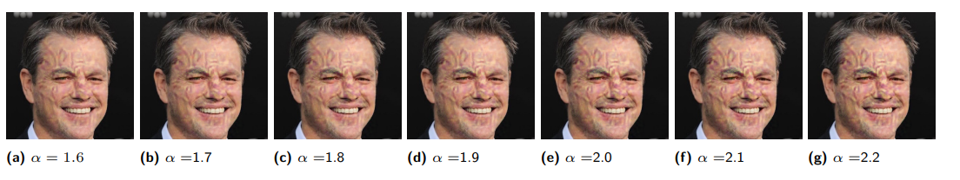
Novelty in our approach
Two New Obfuscation Approaches
Boundary box (decision based adversarial attack)
Generative Style Transfer
Black Box
Obviously wrong recognition
Almost right recognition
Notes:
Additional Surrogate Model:
In order to show transferability they trained 2 6 layered CNNs for classifying MNIST and CIFAR10 datasets.
We can add a vision transformer as another surrogate model (BUT wont it be an overkill)?
No we are planning to add it next to facenet and centernet

Slide 12
Novelty in our approach
Eyes Off: Make the obfuscation even more selective:
Only on some salient features: eyes, nose etc.
Notes:
Additional Surrogate Model:
In order to show transferability they trained 2 6 layered CNNs for classifying MNIST and CIFAR10 datasets.
We can add a vision transformer as another surrogate model (BUT wont it be an overkill)?
Maybe we are planning to add it next to the commercial models, not for the transferability case.

Slide 13
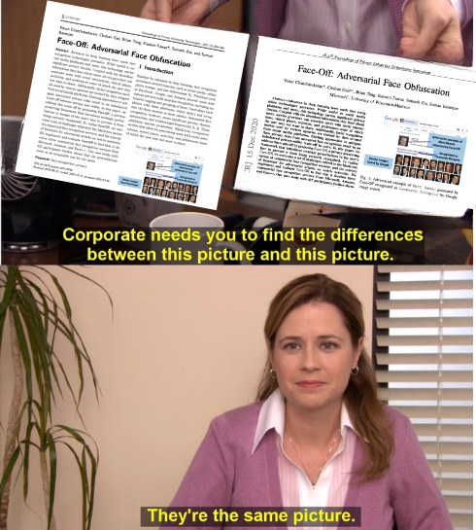
Novelty in our approach
Add a new surrogate model:
Vision Transformer
6 layer CNN?
Notes:
Additional Surrogate Model:
In order to show transferability they trained 2 6 layered CNNs for classifying MNIST and CIFAR10 datasets.
We can add a vision transformer as another surrogate model (BUT wont it be an overkill)?
Maybe we are planning to add it next to the commercial models, not for the transferability case.

Slide 14
Future Direction & Open Issues: Dataset Access
Dataset Name | Identities / Samples | Access
LFW ^{[a]} | 5,749 / 13,233 | Accessible
VGGFace2 ^{[b]} | 9,131 / 3,310,000 | Stopped
Celeb ^{[c]} | 100,000 / 10,000,000 | Stopped
FaceScrub ^{[d]} | 530 / 106,863 | Accessible
PubFig ^{[e]} | 200 / 58,797 | Accessible
a) G. B. Huang, M. Mattar, T. Berg, and E. Learned-Miller, “Labeled faces in the wild: A database for studying face recognition in unconstrained environments,” 2008.
b) Q. Cao, L. Shen, W. Xie, O. M. Parkhi, and A. Zisserman, “Vggface2: A dataset for recognising faces across pose and age,” in 2018 13th IEEE International Conference on Automatic Face & Gesture Recognition (FG 2018). IEEE, 2018, pp. 67–74.
c) Y. Guo, L. Zhang, Y. Hu, X. He, and J. Gao, “Ms-celeb-1m: A dataset and benchmark for large-scale face recognition,” in European conference on computer vision. Springer, 2016, pp. 87–102.
d) Garofalo, G., Rimmer, V., Preuveneers, D., & Joosen, W. (2018). Fishy faces: Crafting adversarial images to poison face authentication. In 12th USENIX Workshop on Offensive Technologies (WOOT 18).
e) Kumar, N., Berg, A. C., Belhumeur, P. N., & Nayar, S. K. (2009, September). Attribute and simile classifiers for face verification. In 2009 IEEE 12th international conference on computer vision (pp. 365-372). IEEE.

Slide 15
Future Direction & Open Issues: What will we do?
Deciding on the dataset
Replicating the work done in Face-Off [7]
Comparing it with the other papers (e.g. Poison Frogs) using the same robust metric
Implementing three new obfuscation approaches and/or an additional surrogate model
Analyzing and documenting the results

Slide 16
Thank you for listening!

